Slide 1


MACHINE LEARNING FOUNDATION
AMAZON EMPLOYEE ACCESS CHALLENEGE
By:
Shashank Kumar
6th July batch

Slide 2
INFORMATION ON DATASET
This dataset contains real historical data collected from 2010 & 2011 of Amazon employees.
It is assumed that employees fulfilling the functions of a given role in the organization will access a resource.
To minimize the human involvement required to grant or revoke this employee access, create a auto access model capable of learning from this historical data to predict approval/denial of resources for employees.
As clear, this is a classification problem.
Number of features is 10 and total records is 32769 with no null values.
4 different models have been developed and each of them evaluated using different techniques.

Slide 3
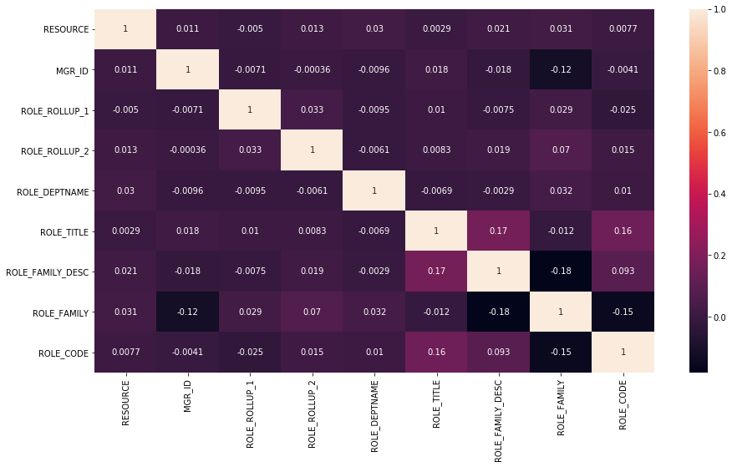
CORRELATION OF FEATURES
Correlation between different features are very mild.

Slide 4
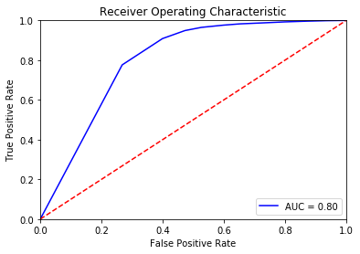
MODEL EVALUATION WITH RANDOM FOREST ALGORITHM
Precision score – 0.96446
Recall score – 0.97968
F1 score – 0.97201
Accuracy score – 0.94678

Slide 5
MODEL EVALUATION WITH RANDOM FOREST ALGORITHM WITH DEFINED HYPERPARAMETERS
Precision score – 0.95996
Recall score – 0.65148
F1 score – 0.77620
Accuracy score – 0.64551

Slide 6
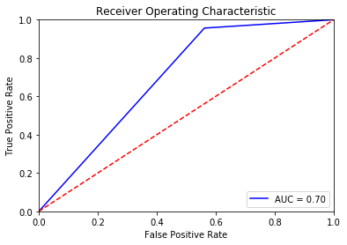
MODEL EVALUATION WITH DECISION TREE ALGORITHM
Precision score – 0.96602
Recall score – 0.95627
F1 score – 0.96112
Accuracy score – 0.92701

Slide 7
MODEL EVALUATION WITH LOGISTIC REGRESSION ALGORITHM
Precision score – 0.94348
Recall score – 1.0
F1 score – 0.97092
Accuracy score – 0.94348

Slide 8
CHOOSING BEST MODEL
As AUC score of model1 and model2(0.8) is better than that of any other models, we need to consider F1 score.
- F1 score for model1(Using RandomForestClassifier) is: 0.9703
F1 score for model2(Using RandomForestClassifier with different hyperparameters) is: 0.7762
So, we will go with model 1.

